Slide 3
YEARLY REVIEW: 2019

Slide 4
Affiliated schools 2019
We again smashed through the milestone 70 schools figure!

Slide 5
Twitter:
1,900 + followers!
@Tyrone_mBunscol

Slide 6
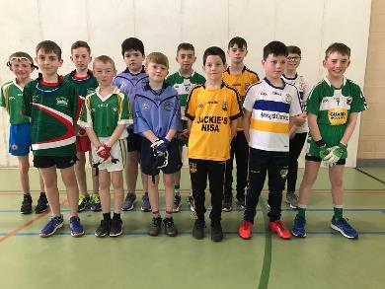
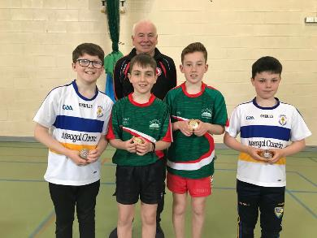
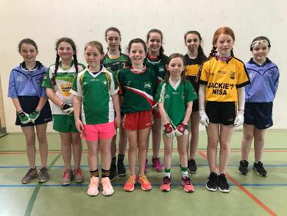
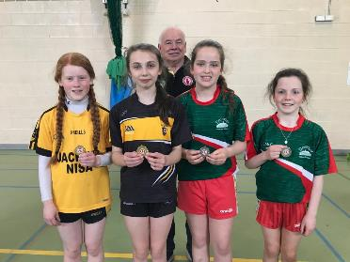
1-Wall Handball:
St. Ciaran’s College,
Ballygawley

Slide 7
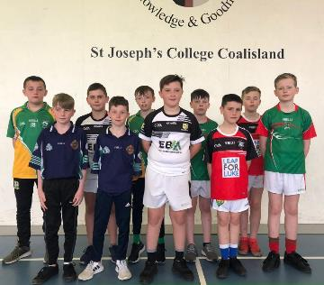
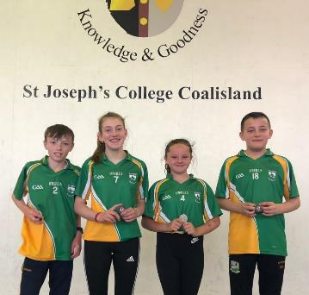
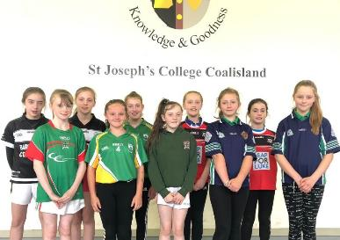
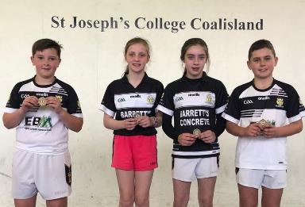
1-Wall Handball:
St. Joseph’s College,
Coalisland

Slide 8
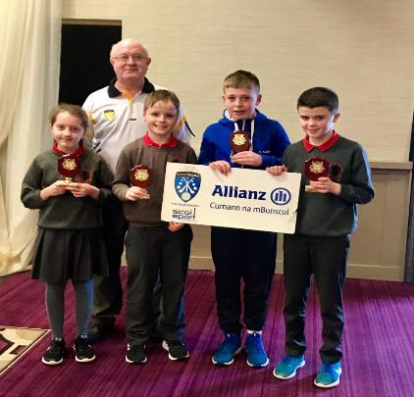
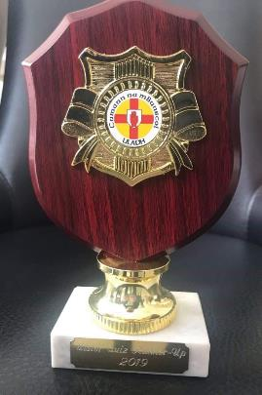
CnmB Quiz: Ulster Final 2019 -
Hillgrove Hotel, Monaghan
St. Teresa’s P.S. Loughmacrory
St. Colmcille’s P.S. Carrickmore
Tyrone Quiz Shield Winners 2019:
St. Teresa’s P.S.
LOUGHMACRORY
50/60 secured 2nd place in Ulster!

Slide 9
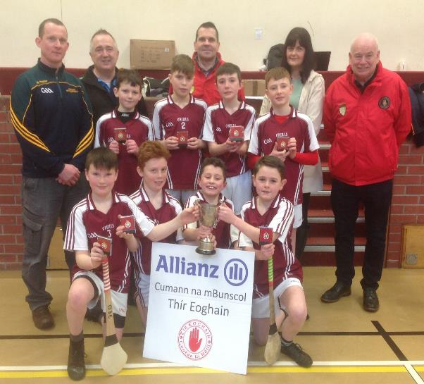
INDOOR HURLING: Tyrone CHAMPIONS 2019
ST. RONAN’S P.S.
RECARSON

Slide 10
INDOOR CAMOGIE: tyrone CHAMPIONS 2019
St. Patrick’s P.S.
Roan

Slide 11
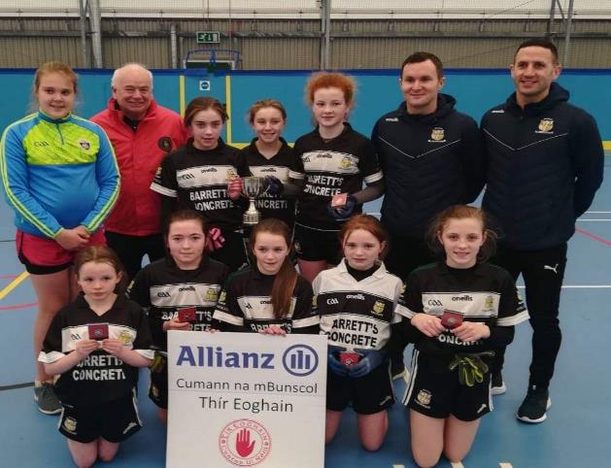
INDOOR girls’ football: TYRONE CHAMPIONS 2019
St. Patrick’s P.S.
ROAN

Slide 12
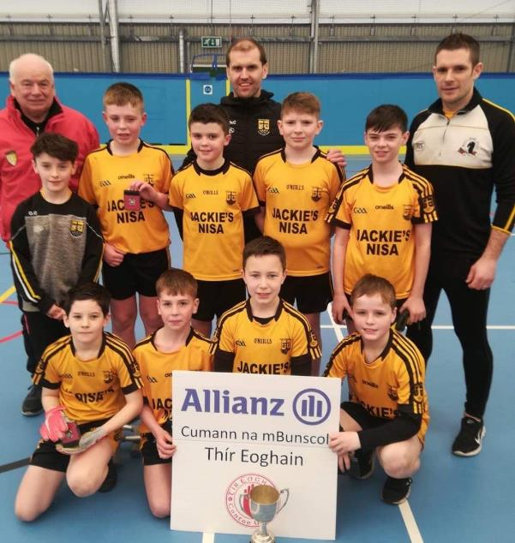
INDOOR BOYS’ FOOTBALL: Tyrone CHAMPIONS 2019
St. Teresa’s P.S.
LOUGHMACRORY

Slide 13
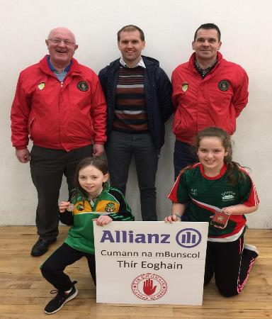
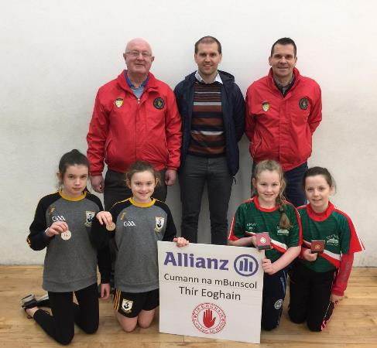
TYRONE 4-Wall HANDBALL: U11 GIRLS – SINGLES & DOUBLES CHAMPIONS 2019
DRUMDUFF P.S.
DRUMDUFF P.S.

Slide 14
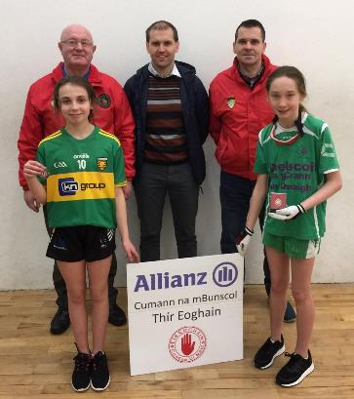
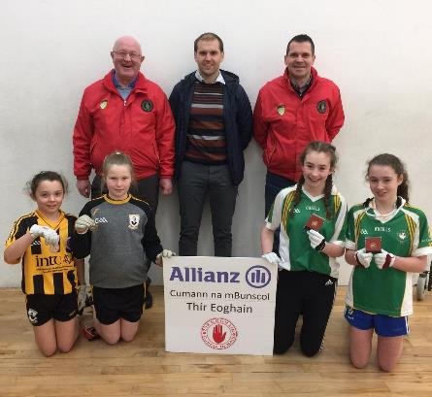
TYRONE HANDBALL: U13 GIRLS – SINGLES & DOUBLES CHAMPIONS 2019
GAELSCOIL Na gCrann
CARRICKMORE

Slide 15
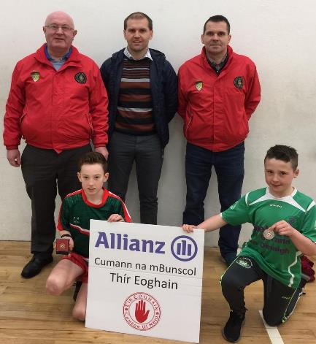
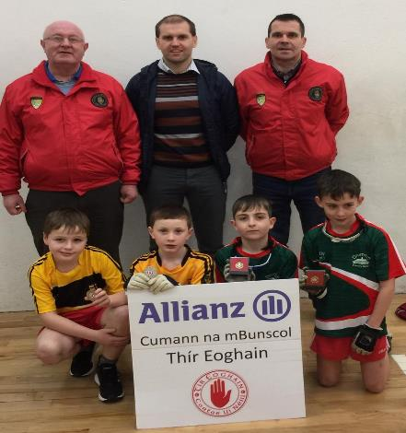
TYRONE HANDBALL: U11 BOYS – SINGLES & DOUBLES CHAMPIONS 2019
DRUMDUFF P.S.
DRUMDUFF P.S.

Slide 16
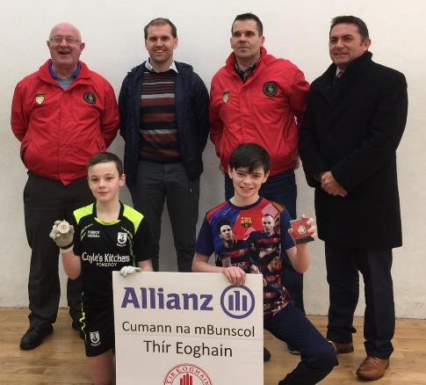
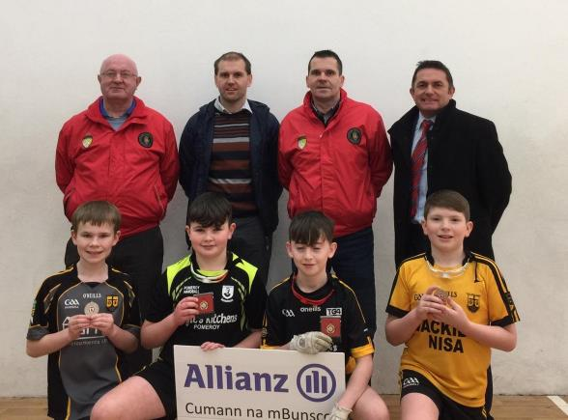
TYRONE HANDBALL: U13 BOYS –
SINGLES & DOUBLES CHAMPIONS 2019
LOUGHMACRORY
POMEROY

Slide 17
Ulster Handball
Champions:
Belfast 2019

Slide 18
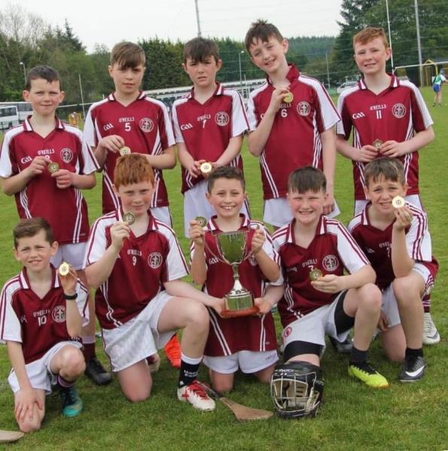
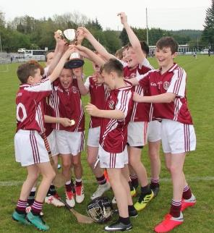
Annual County Outdoor Hurling Tournament: Carrickmore
Winners:
St. Ronan’s P.S.
RECARSON

Slide 19
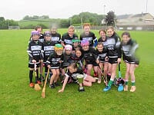
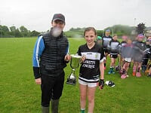
Annual County Outdoor Camogie Tournament: Eglish
Captain Gemma Daly from Winners:
Roan P.S.

Slide 20
FINALS’ DAY 2019
Garvaghey Complex

Slide 21
A | Niall McQuaid Primate Dixon P.S. Coalisland | I | Barry Conroy Oliver Plunkett P.S. Beragh
B | Emmet O’Neill St Colmcille’s P.S. Carrickmore | J | John Quinn St Peter’s P.S. Moortown
C | Jarlath McElholm Sacred Heart P.S. Tattyreagh | K | Eunan McGinn Sacred Heart P.S. Rock
D | John Cunningham Knocknagor P.S. | L | Fabian McGlone St Patrick’s P.S. N’stewart
E | Mark McCullagh St. Teresa’s P.S. Loughmacrory | M | Brian McGurk St Patrick’s P.S. Castlederg
F | Gerard Poyntz Drumduff P.S. | N | Philip O’ Neill St John’s P.S. Kingsisland
G | Gemma Quinn St Patrick’s P.S. Aughadarragh | O | Seamus McCreesh St. Mary’s P.S. Cabragh
H | Anne McAlinden Edendork P.S. | P | Anne Daly Tyrone GAA
 |  | Q | Mary Grugan St Patrick’s P.S. Gortin

Slide 22
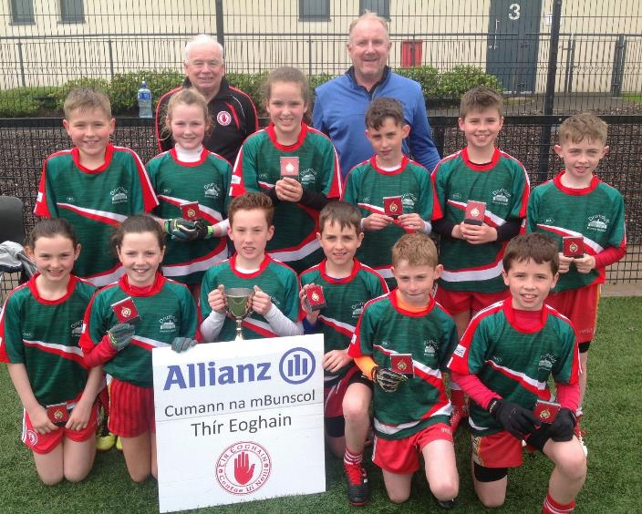
IGGY JONES’
CUP
2019
DRUMDUFF P.S.

Slide 23
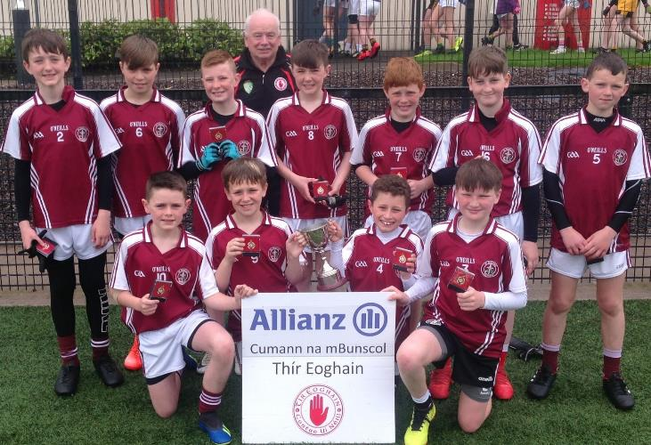
THADDY
TURBITT
CUP 2019
St. Ronan’s P.S.
RECARSON

Slide 24
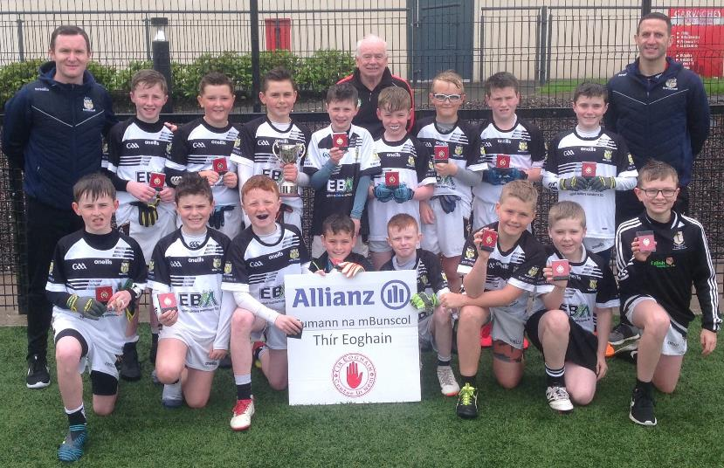
Cumann na mBunscol Cup
ROAN St. Patrick’s P.S.

Slide 25
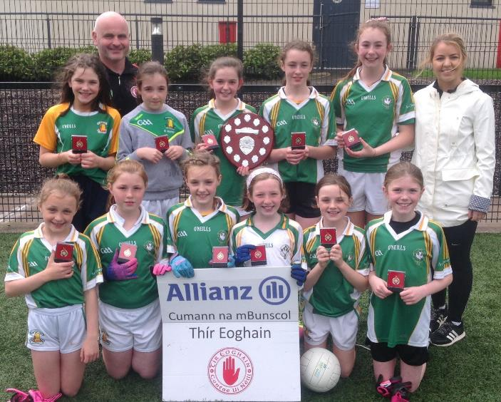
LADIES’
SHIELD
2019
St. Colmcille’s P.S.
CARRICKMORE

Slide 26
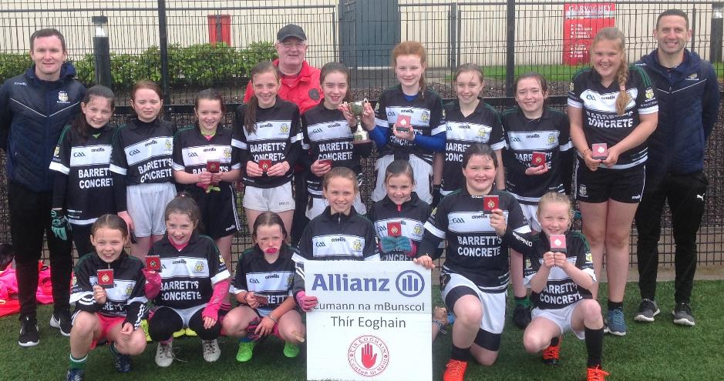
LADIES’
CUP Winners 2019
St. Patrick’s P.S.
ROAN

Slide 27
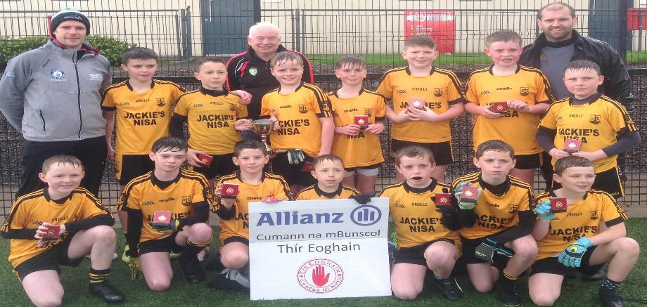
ALLIANZ CUP
St. Teresa’s P.S. LOUGHMACRORY

Slide 28
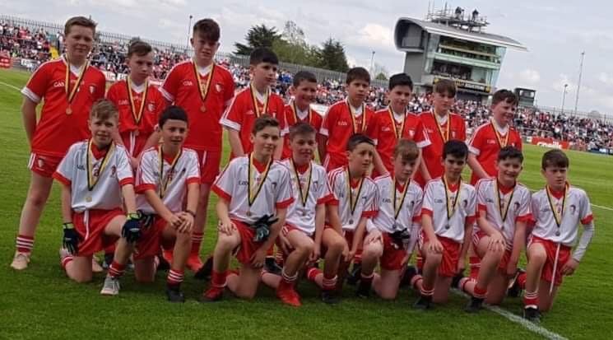
Tír Eoghain v Doire Preliminary Rd
Ulster SFC Mini Games: Sunday 12 May 2019

Slide 29
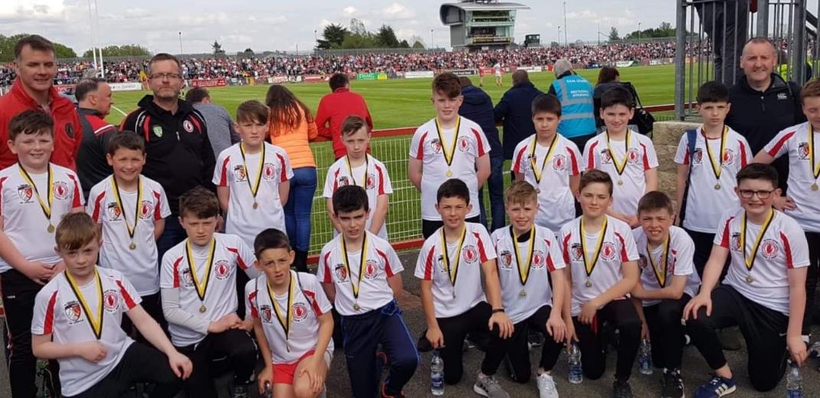
Commemorative t-shirts

Slide 30
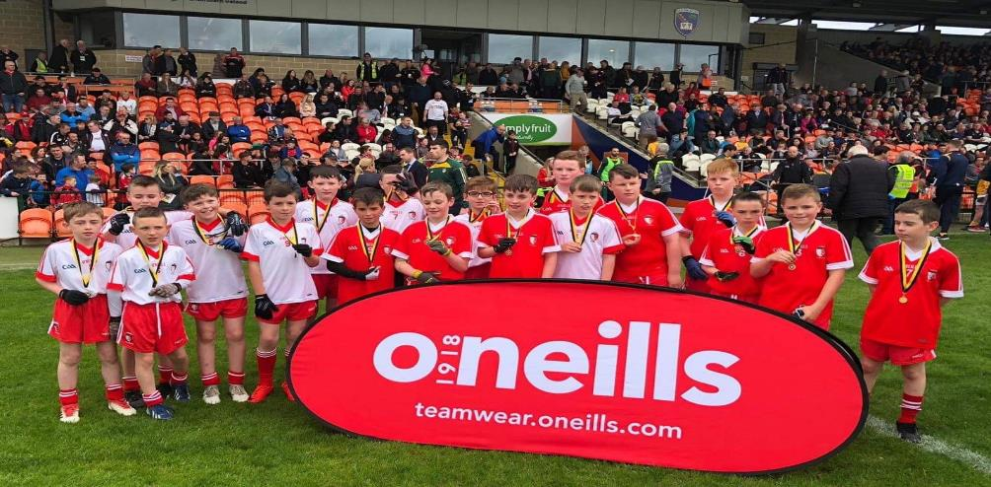
Tír Eoghain v Aontroim ¼ Final
Ulster SFC Mini Games: Sat 25 May 2019

Slide 31
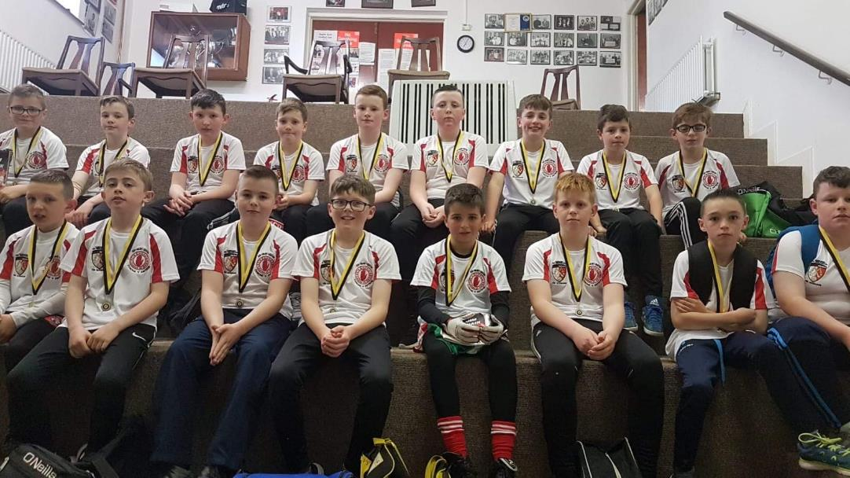
Commemorative t-shirts

Slide 33
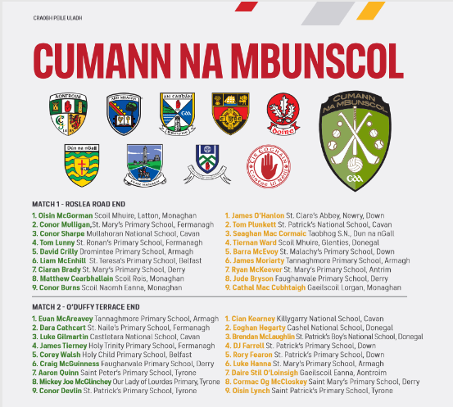
An Cabhán v Dún na nGall:
Ulster SFC Final Sunday 23 June 2019
Darren McAnespie
St. Mary’s P.S. Aughnacloy
Eoghan Conway
Our Lady of Lourdes P.S. Greencastle
Darragh Devlin
St. Patrick’s P.S. Mullinahoe
Ross Daly
Roan St. Patrick’s P.S.

Slide 34
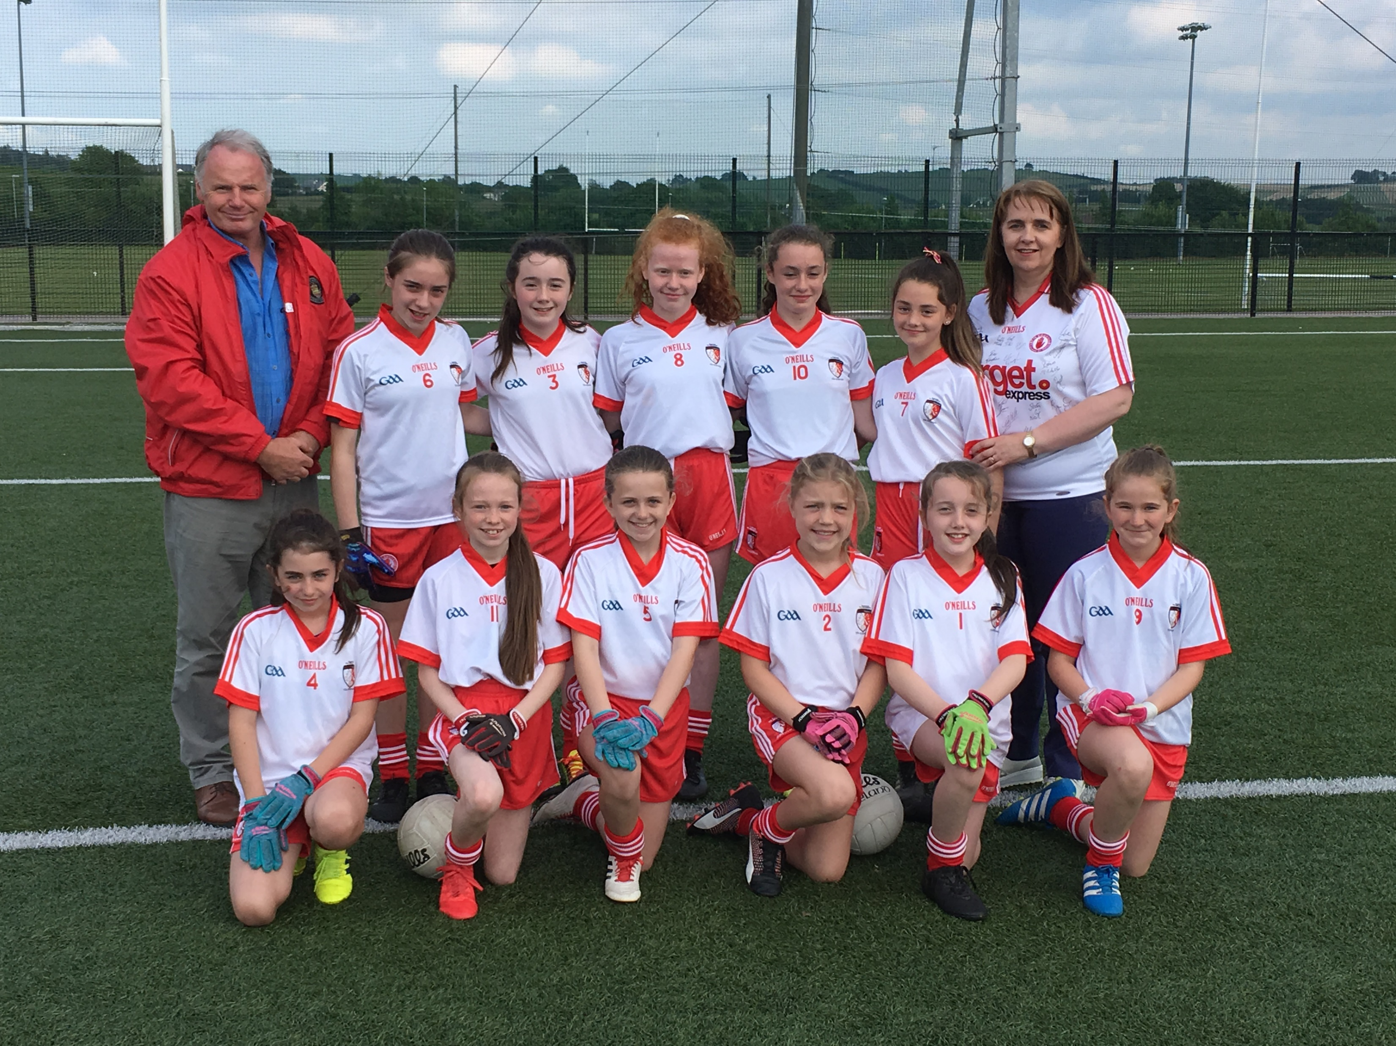
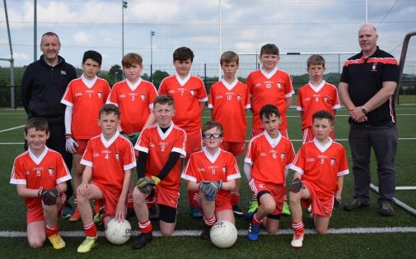
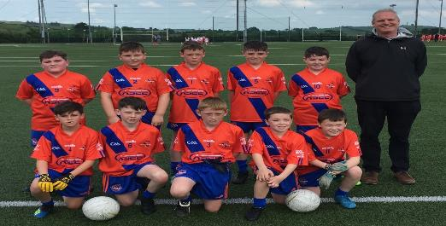
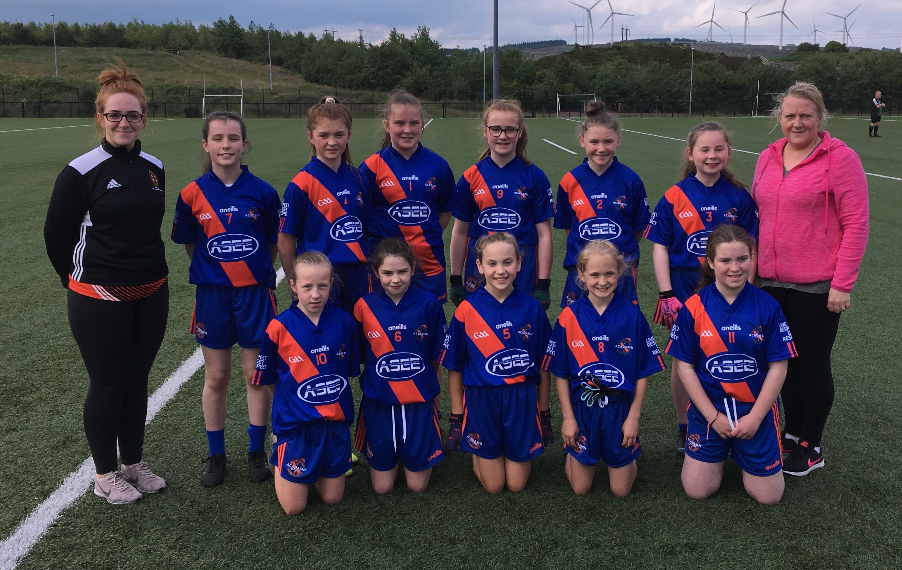
Ard Mhaca v Tír Eoghain v ‘Friendly’ lol
Garvaghey: June 2019

Slide 35
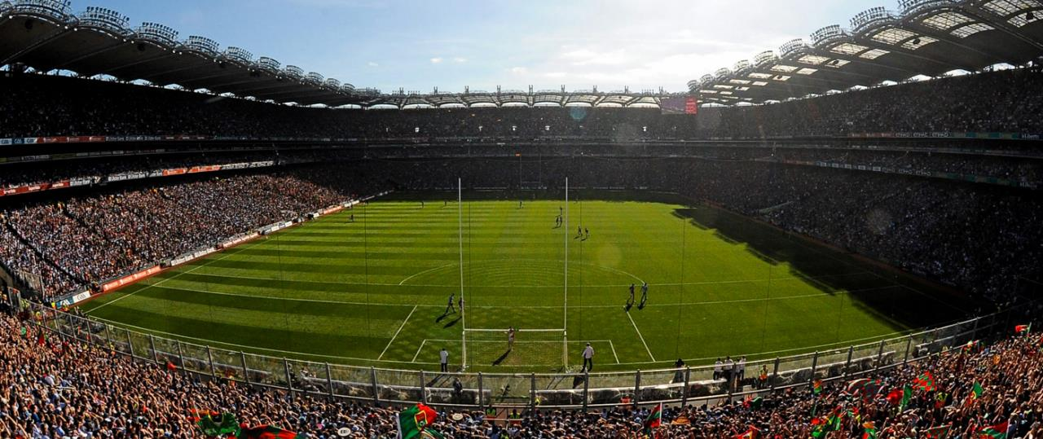
Páirc an Chrócaigh

Slide 36
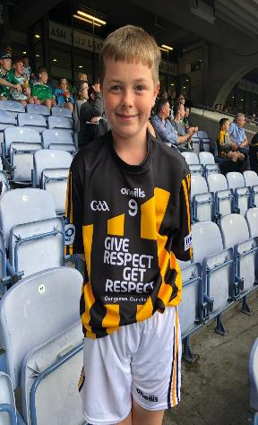
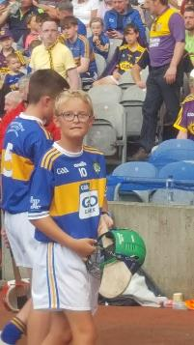
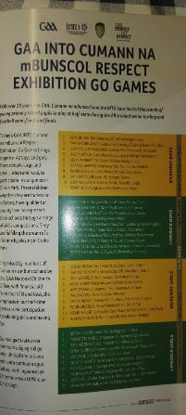
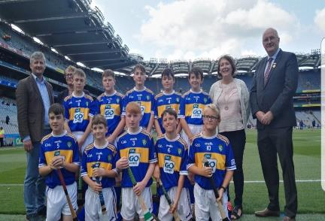
All-Ireland SHC Semi-Final
Cody Gallagher: Roan St. Patrick’s P.S.
Cahir Keyes: All Saints’ P.S. Tattysallagh

Slide 37
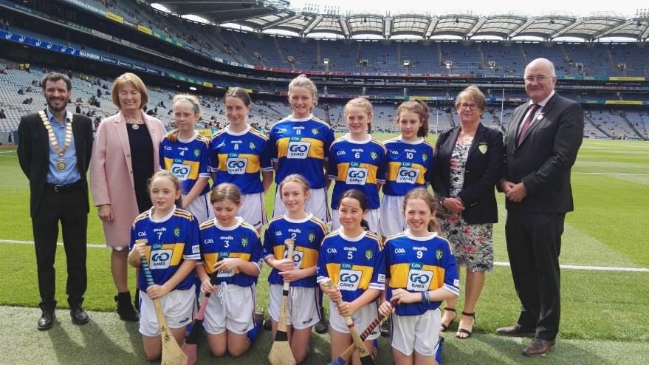
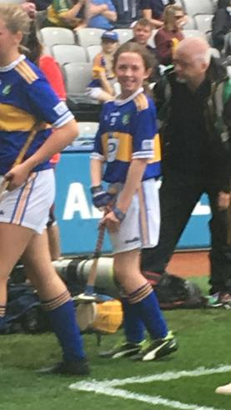
All-Ireland SHC Final
Catherine Moohan: St. Patrick’s P.S. Dungannon

Slide 38
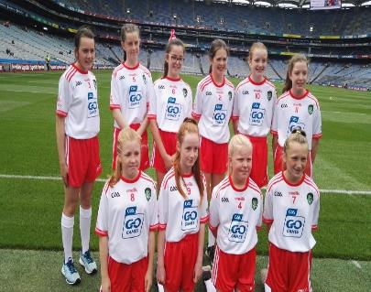
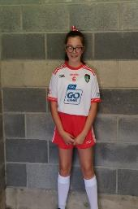
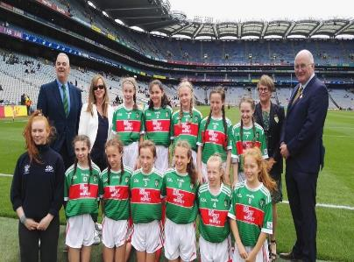
All-Ireland SFC Semi-Final
Ella Tracey
St. Mary’s P.S. Dunamore
Laura Duff
St. Teresa’s P.S.
Loughmacrory

Slide 39
All-Ireland SFC Final:
Pearse McDonald: St. Teresa’s P.S. Loughmacrory

Slide 40
Small GAA School of The Year: 2019 Award

Slide 41
Go raibh maith agaibh
TEAMTALKmag.com
Noel, Damian, Benny
& Kevin
Eugene McConnell PRO
Mark Conway Club Tyrone
Benny Hurl Coaching & Games
Brian Laverty, Coaches & Staff Garvaghey

Slide 42
Sin é
Comhghairdeas go léir!
Tír Eoghain abú

